Slide 1
BASIC BANKING PROTOTYPE
[19] SANTOSH DAHAL

Slide 2
Outline
Introduction
Problem Statement
Objective
Scope
Limitations
Literature Review/Background Study
Methodology
Tools and Technology
Conclusion
Reference

Slide 3
Introduction
The Basic Banking Prototype is an online banking system built using PHP and MySQL, designed for educational purposes.
This system mimics real-life banking scenarios, allowing users to perform internet banking operations like account management, fund transfers, and viewing bank statements.
In this banking system we use php , xampp and mysql database.
Basic Banking Prototype system has two module i.e. customer and staff.

Slide 4
Problem Statement
Traditional banking systems often suffer from inefficiencies and limited accessibility.
In the face of evolving digital demands, traditional banking systems are challenged by slow processing times, accessibility issues, and outdated technology, leading to decreased customer satisfaction and increased operational costs.
This project aims to develop a user-friendly online banking prototype to demonstrate the functionalities and benefits of digital banking, particularly for educational purposes.

Slide 5
Objective
To provide a functional online banking system for educational use.
To simulate real-life banking operations like account management, fund transfers, and statement viewing.
To offer a practical learning resource for IT students.
Provide remote banking services to users, ensuring accessibility for customers in all regions.
Build a scalable system architecture for future expansions and technology integrations

Slide 6
Limitation
The prototype may not encompass all features and functionalities of a comprehensive banking system, such as investment management or loan processing.
The prototype may face challenges in scaling up to accommodate a large user base or increasing transaction volumes, leading to potential performance issues.
Compliance with banking regulations and standards may not be fully addressed in the prototype, requiring additional validation and adjustments to meet legal requirements.
While security measures are implemented, the prototype may still be vulnerable to cyber threats and data breaches, especially if not regularly updated and maintained.

Slide 7
Scope
Implementation of staff and customer panels.
Online banking registration and account creation.
Allowing users to create, modify, and manage their banking accounts securely.
Facilitating various transactions such as fund transfers, and account inquiries.
Ensuring the platform is accessible across multiple devices and web browsers to accommodate diverse user preferences.

Slide 8
Background Study
Online Banking Systems: Online banking systems allow customers to perform financial transactions over the internet, providing 24/7 access to banking services. Users can check balances, transfer funds, pay bills, and manage beneficiary accounts without visiting a bank branch.
Case Study: Nabil Bank nBank
Key Features
Mobile Banking: Access via smartphone
Bill Pay: Integrate online bill payment service
Alerts and Notifications: Customizable account activity alerts.
Customer Service: 24/7 support through chat and phone services.
The Basic Banking Prototype integrates these principles to provide a secure, efficient, and user-friendly online banking system, focusing on robust security, user-friendly interfaces, and comprehensive transaction management.

Slide 9
Literature Review
Junaid Ashraf: "Design and Implementation of an Online Banking System in PHP" explores essential features and user requirements, focusing on user-friendly interfaces and secure transactions to enhance user satisfaction and trust.
Priya Sharma and Ankit Patel: "Secure Online Transactions in Banking Systems: A Review" defines necessary security measures, emphasizing encryption, two-factor authentication, and regular security audits to protect user data and maintain transaction integrity.
Kiran Kumar and Suman Reddy: "User Experience in Online Banking: A Comparative Analysis" highlights the impact of user interface design, arguing that intuitive navigation, responsive design, and personalized dashboards significantly improve user engagement and satisfaction.
Nabil Bank: This research explores the application of intelligent support tools in managing digital resources, suggesting that automated tools can streamline data entry and record-keeping processes in online banking systems.

Slide 10
Methodology
Waterfall Model
To gain the objectives of this project use waterfall model . In this project requirements are very clear, understood and fixed.
It is suitable in small project.
It is the method where the model is designed, implemented , and tested.

Slide 11
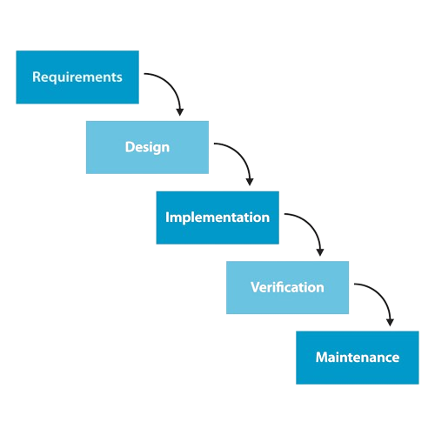
Waterfall Methodology

Slide 12
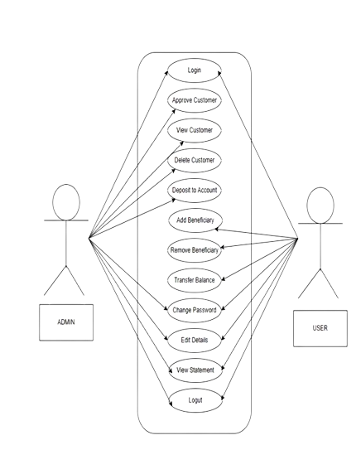
Use case Diagram

Slide 13
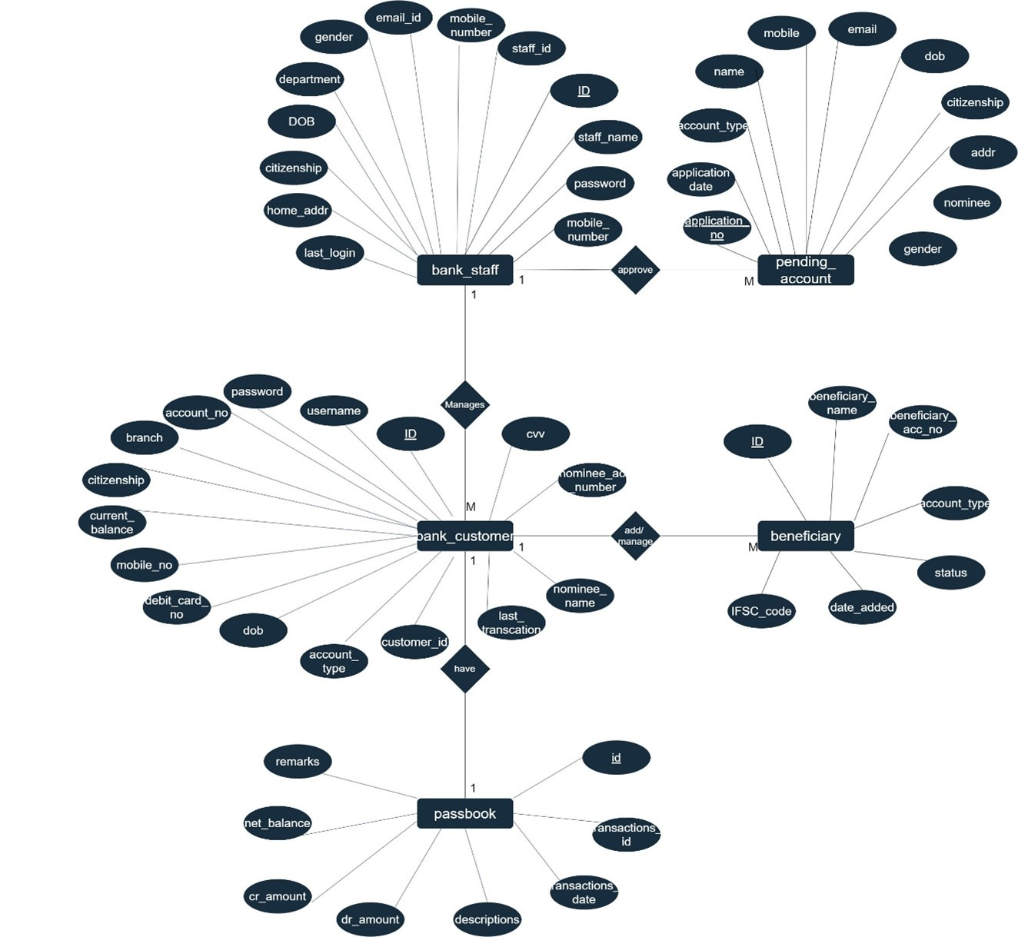
ER-Diagram

Slide 14
Tools and technology
Front End tools
HTML,
CSS
JavaScript
bootstraps
Back End Tools
PHP
MYSQL

Slide 15
Conclusion
In summary, the Basic Banking Prototype aims to deliver a secure, easy-to-use, and efficient online banking experience. By using advanced design features, and smart management tools, this system meets all necessary requirements. The development process follows the Waterfall models to ensure reliability and scalability. This project not only fulfills current user needs but also prepares for future improvements in online banking, ensuring continued user satisfaction and smooth operations.

Slide 16
References
[1] Ashraf, Junaid. "Design and Implementation of an Online Banking System in PHP." [ONLINE] Available: Junaid Ashraf - Software Development Manager - u-blox | LinkedIn. Accessed: [2024].
[2] Sharma, Priya, and Patel, Ankit. "Secure Online Transactions in Banking Systems: A Review." [ONLINE] Available: (PDF) A Review of Cyber Security Issues in Online Banking and Online Transactions (researchgate.net). Accessed: [2023].
[3] Kumar, Kiran, and Reddy, Suman. "User Experience in Online Banking: A Comparative Analysis." [ONLINE] Available: 334f5e51acce0b4eef5a63b1845c6e672895.pdf (semanticscholar.org). Accessed:[22024].
[4] Nabil Bank. "Intelligent Support Tools in Managing Digital Resources: A Case Study." [ONLINE] Available: https://www.nabilbank.com/services-payments/services/individuals/nbank Accessed: [2021-2024].
[5] "Financial Times" | [ONLINE] | Available: https://www.ft.com/ | [Accessed - 2024]
[6] "The Economist - Finance and Economics" | [ONLINE] | Available: https://www.economist.com/finance-and-economics | [Accessed 2023]
[7] "Investopedia" | [ONLINE] | Available: https://www.investopedia.com | [Accessed 2023]

Slide 17
~The End~

